Slide 1
Song Analysis
Task-3

Slide 2
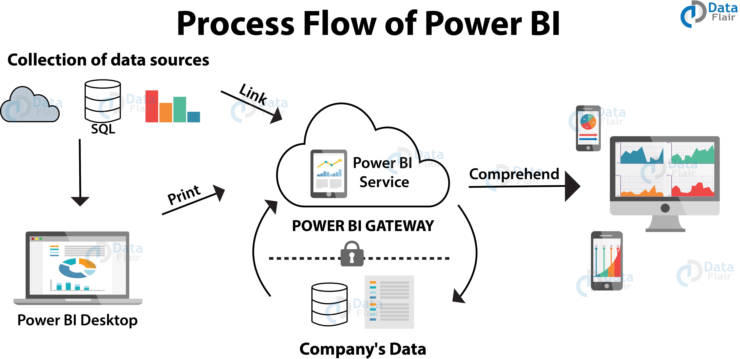
Introduction
Song analysis using YouTube data and Power BI can provide valuable insights for artists and music industry professionals.
By leveraging Power BI's data visualization capabilities, users can uncover trends, patterns, and audience preferences.
This presentation will explore the process and benefits of analyzing song data from YouTube with Power BI.
1
Notes:
Image source: https://data-flair.training/blogs/power-bi-tutorial/

Slide 3
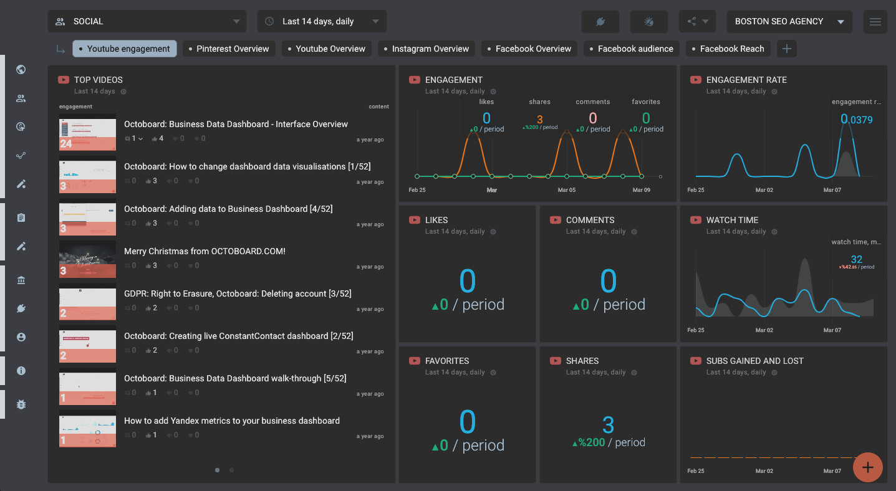
Data Collection
YouTube provides a wealth of data on song performances, views, engagement metrics, and audience demographics.
Power BI can easily connect to YouTube APIs to pull in relevant data for analysis.
Data collection is crucial for understanding the performance and impact of songs on the platform.
2
Notes:
Image source: https://www.octoboard.com/social-media-reporting-tool/youtube-automated-reports/youtube-engagement-report-automated

Slide 4
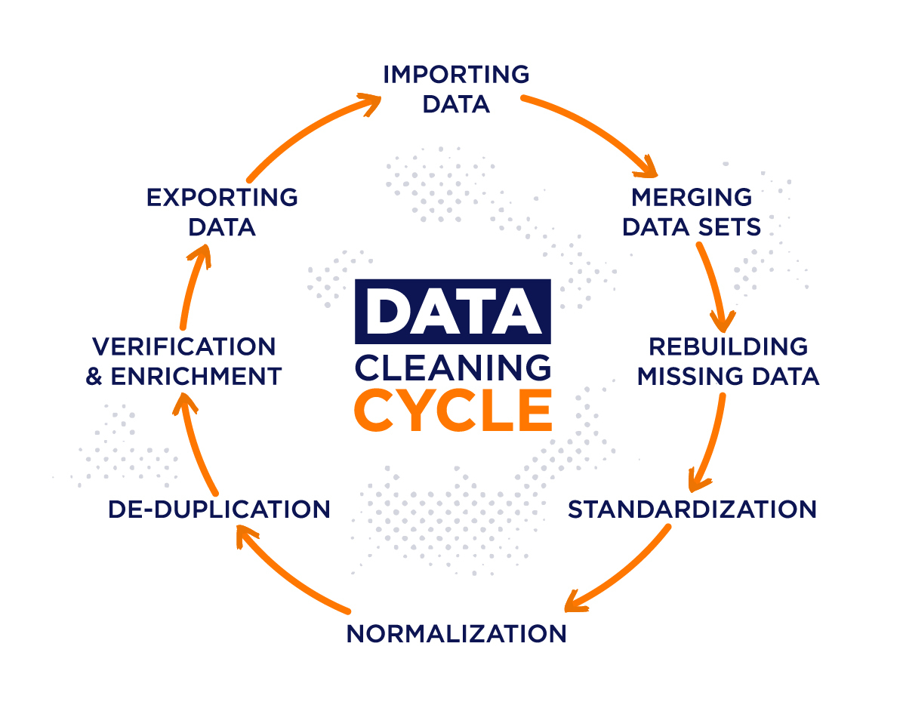
Data Preparation
Before analysis, data from YouTube needs to be cleaned, transformed, and structured in Power BI for meaningful insights.
Power BI offers tools for data cleaning, shaping, and modeling to ensure accuracy and reliability.
Proper data preparation is essential for accurate analysis and visualization.
3
Notes:
Image source: https://www.iteratorshq.com/blog/data-cleaning-in-5-easy-steps/

Slide 5
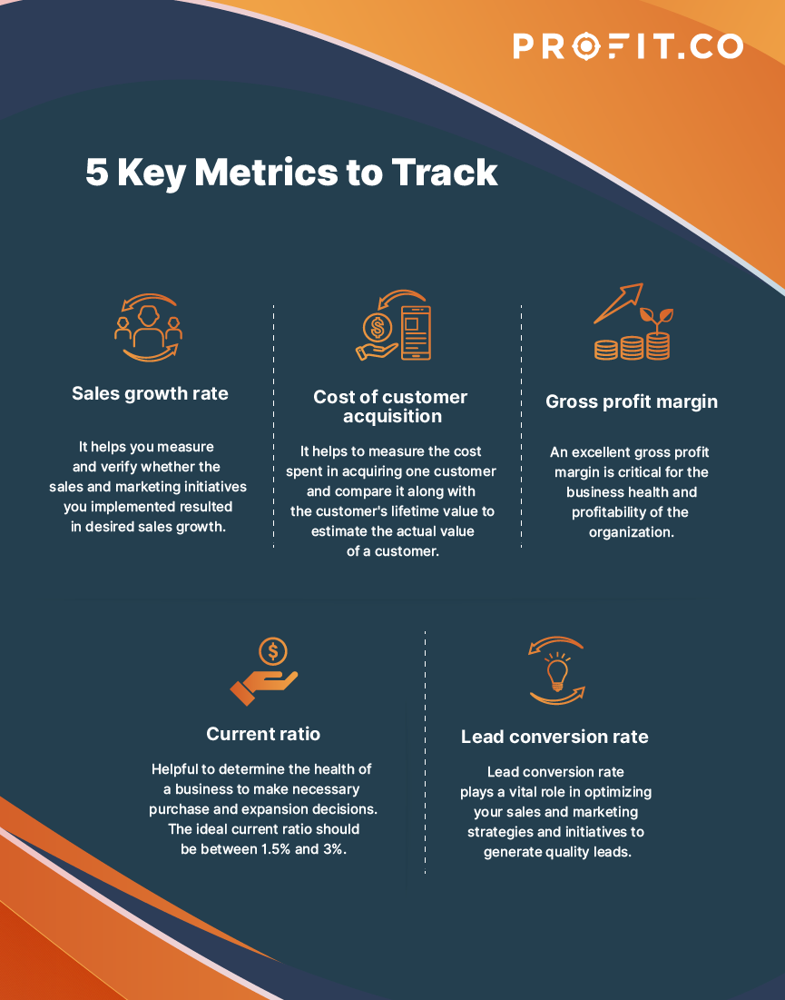
Key Metrics
Important metrics for song analysis on YouTube include views, likes, comments, shares, and audience retention.
Power BI enables users to create interactive dashboards and reports to track these metrics over time.
Understanding key metrics can help identify successful songs and optimize future content strategies.
4
Notes:
Image source: https://www.profit.co/blog/kpi-library/what-are-metrics-and-key-metrics-why-are-key-metrics-important/

Slide 6
Audience Demographics
Analyzing audience demographics such as age, gender, location, and interests can provide insights into target audiences.
Power BI's demographic analysis capabilities allow users to segment audiences and tailor content accordingly.
Understanding audience demographics is essential for effective marketing and promotion strategies.
5
Notes:
Image source: https://www.similarweb.com/blog/research/audience-and-brand-building/types-of-audience-analysis/

Slide 7
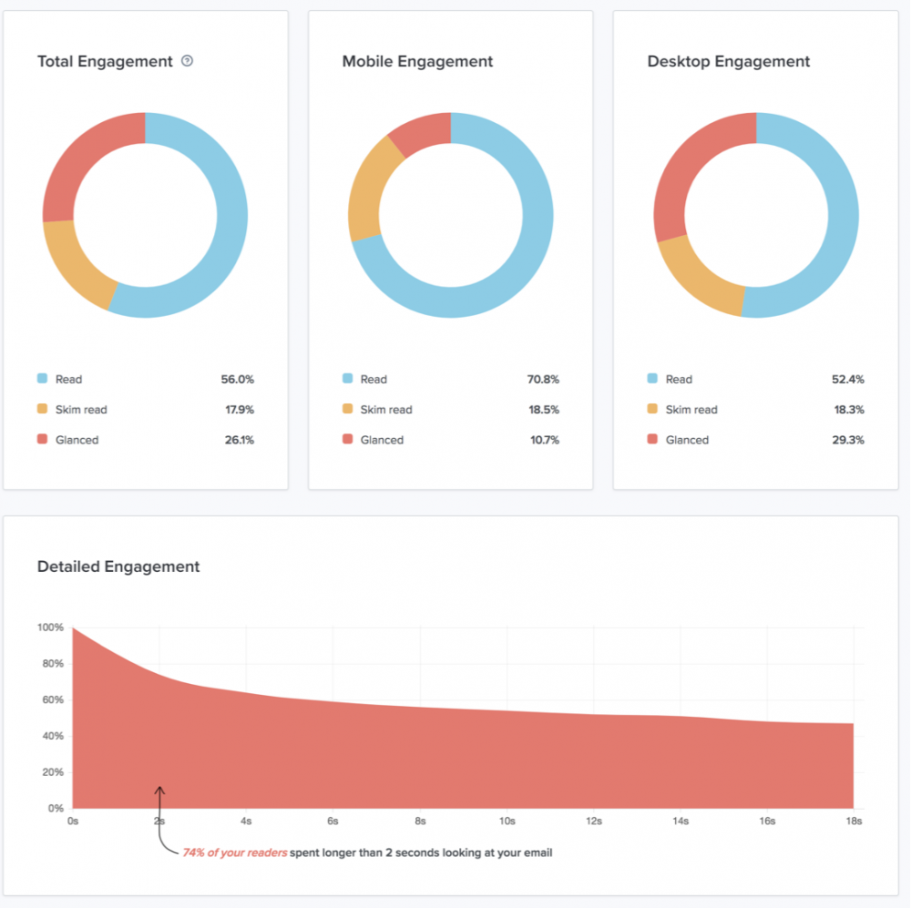
Engagement Analysis
Monitoring engagement metrics like likes, comments, and shares can indicate audience interest and interaction with songs.
Power BI's visualization tools can help track engagement trends and patterns for individual songs.
Analyzing engagement data can guide artists in creating more engaging and impactful content.
6
Notes:
Image source: https://help.litmus.com/article/164-how-are-engagement-metrics-defined

Slide 8
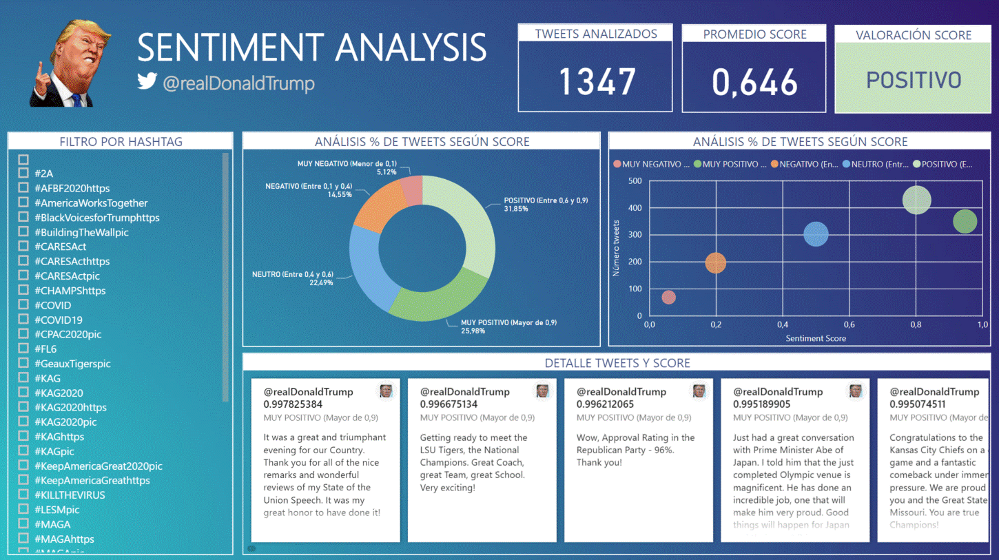
Sentiment Analysis
Sentiment analysis tools in Power BI can assess audience sentiment towards songs based on comments and feedback.
Understanding audience sentiment can help artists gauge the overall reception and perception of their music.
Sentiment analysis can provide valuable insights for improving song quality and connecting with audiences emotionally.
7
Notes:
Image source: https://mavink.com/explore/Sentiment-Analysis-Power-BI

Slide 9
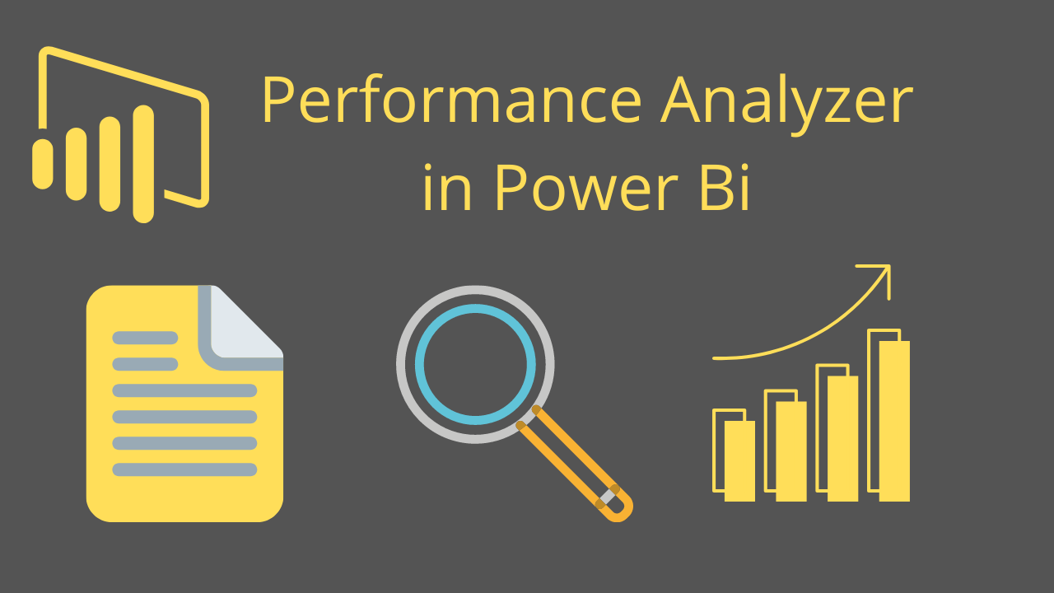
Performance Comparison
Power BI allows users to compare the performance of multiple songs based on key metrics like views, likes, and engagement.
Comparative analysis can help artists identify top-performing songs and understand factors contributing to success.
Performance comparison can guide decision-making and strategy development for future song releases.
8
Notes:
Image source: https://powerbidocs.com/2019/12/08/power-bi-performance-analyzer/

Slide 10
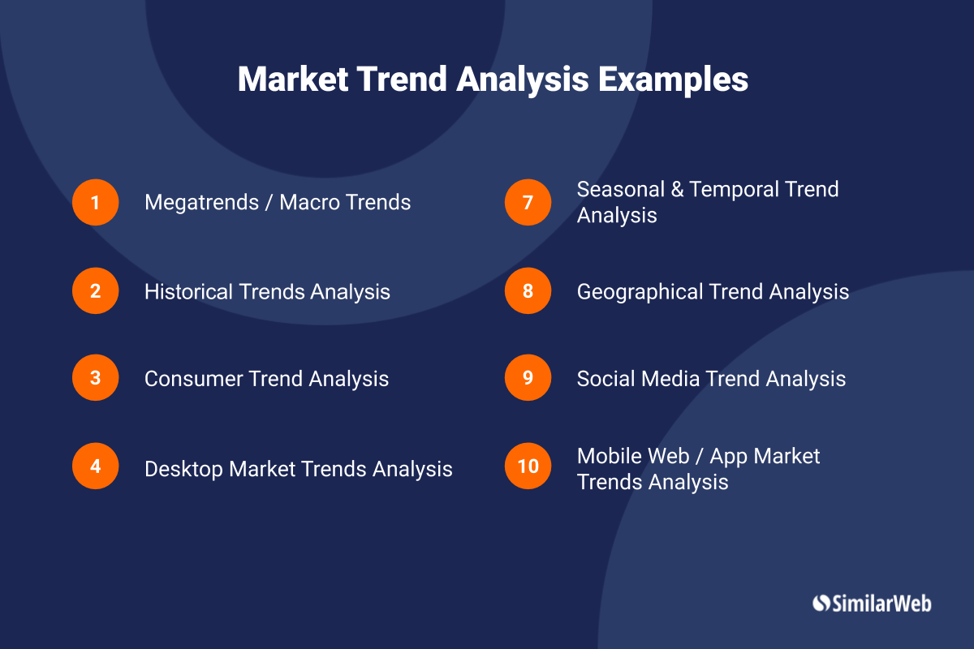
Trend Analysis
Analyzing trends in song performance over time can reveal patterns, seasonality, and audience preferences.
Power BI's trend analysis features enable users to visualize performance trends and make data-driven decisions.
Trend analysis can help artists adapt to changing market dynamics and stay ahead of competition.
9
Notes:
Image source: https://www.similarweb.com/corp/blog/research/market-research/market-trend-analysis/

Slide 11
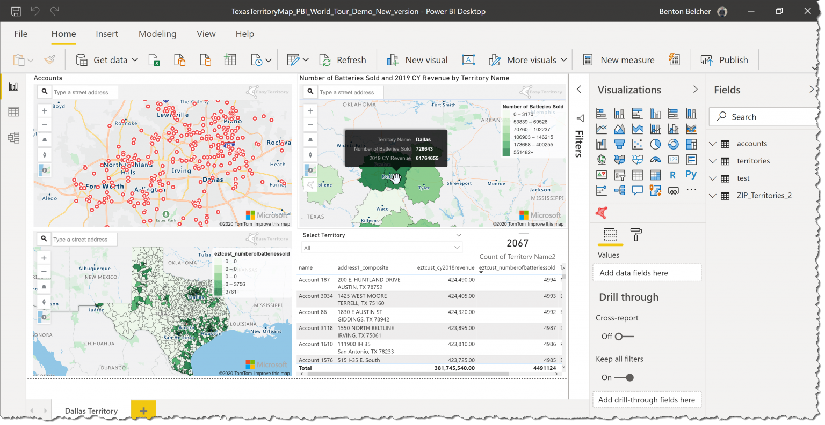
Geographic Insights
Power BI's mapping capabilities can provide insights into the geographic distribution of song viewership and engagement.
Analyzing regional preferences and trends can help artists target specific markets and plan promotional activities.
Geographic insights can inform tour planning, marketing campaigns, and global expansion strategies.
10
Notes:
Image source: https://mungfali.com/explore/Power-BI-Map-Data-Labels

Slide 12
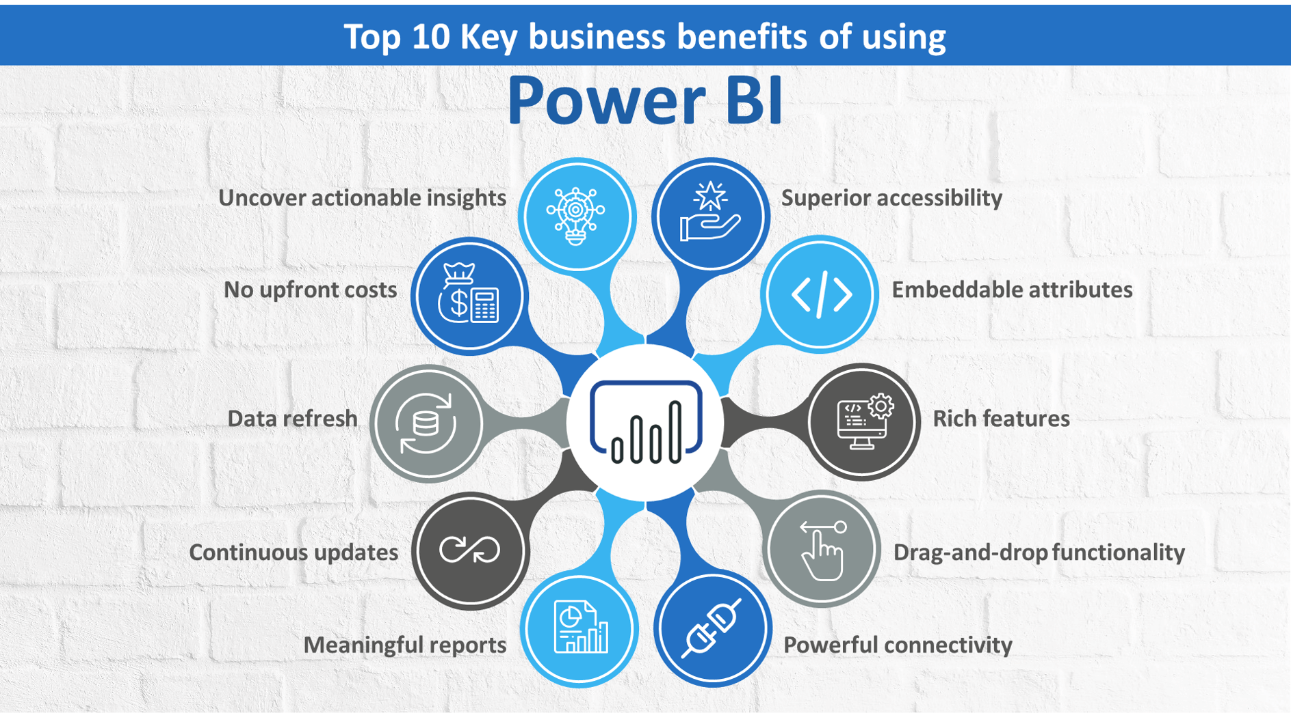
Collaborations and Features
Power BI enables users to analyze the impact of collaborations and featured artists on song performance.
Understanding the influence of collaborations can help artists form strategic partnerships and expand their audience reach.
Analyzing collaborations and features can uncover synergies and opportunities for mutual growth.
11
Notes:
Image source: https://www.epcgroup.net/power-bi-embedded-vs-power-bi-service-understanding-difference/

Slide 13
Actionable Insights
By analyzing song data with Power BI, users can extract actionable insights to drive decision-making and strategy.
Actionable insights can help artists optimize content, engage with audiences effectively, and maximize song performance.
Power BI empowers users to transform data into actionable recommendations for achieving music industry success.
13
Notes:
Image source: https://datasciencedojo.com/blog/data-analyst-uses-power-bi/

Slide 14
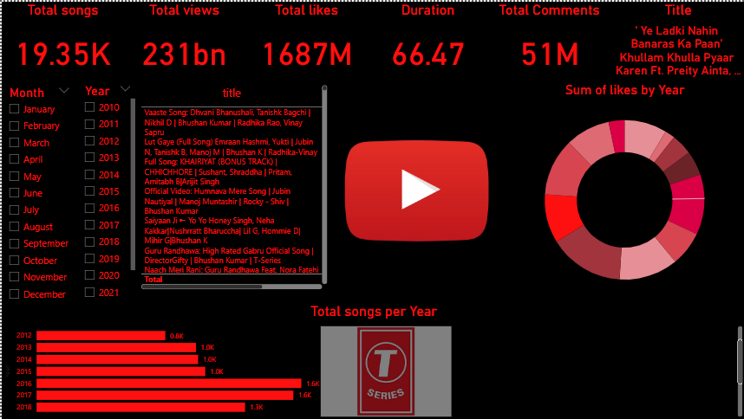
My Report:
13
Notes:
Image source: https://datasciencedojo.com/blog/data-analyst-uses-power-bi/

Slide 15
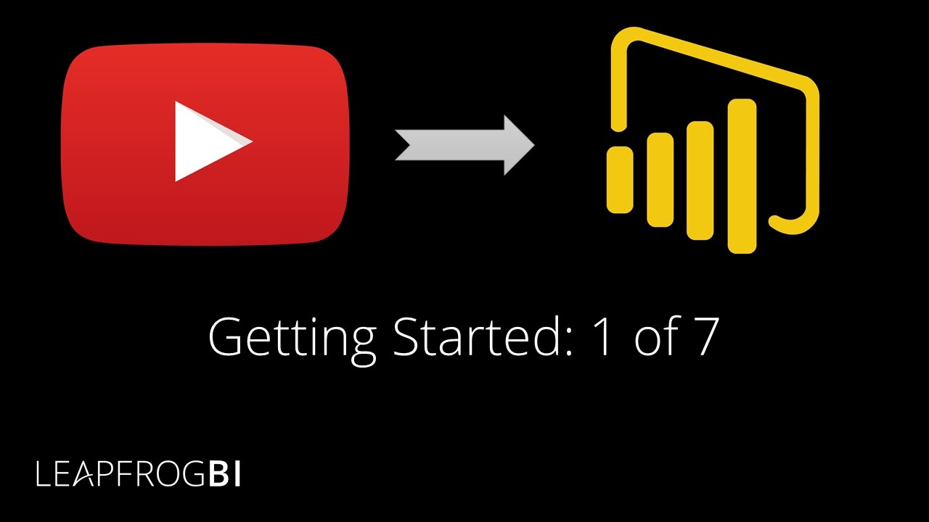
Conclusion
Song analysis by YouTube with Power BI offers a powerful tool for understanding audience preferences, trends, and performance metrics.
By leveraging Power BI's capabilities, artists and music industry professionals can make informed decisions and drive success in the competitive music landscape.
Embracing data-driven analysis can unlock new opportunities, enhance creativity, and propel artists towards their goals.
14
Notes:
Image source: http://fity.club/lists/y/youtube-analytics-101-the-complete-guide-to-getting-started/

Slide 16
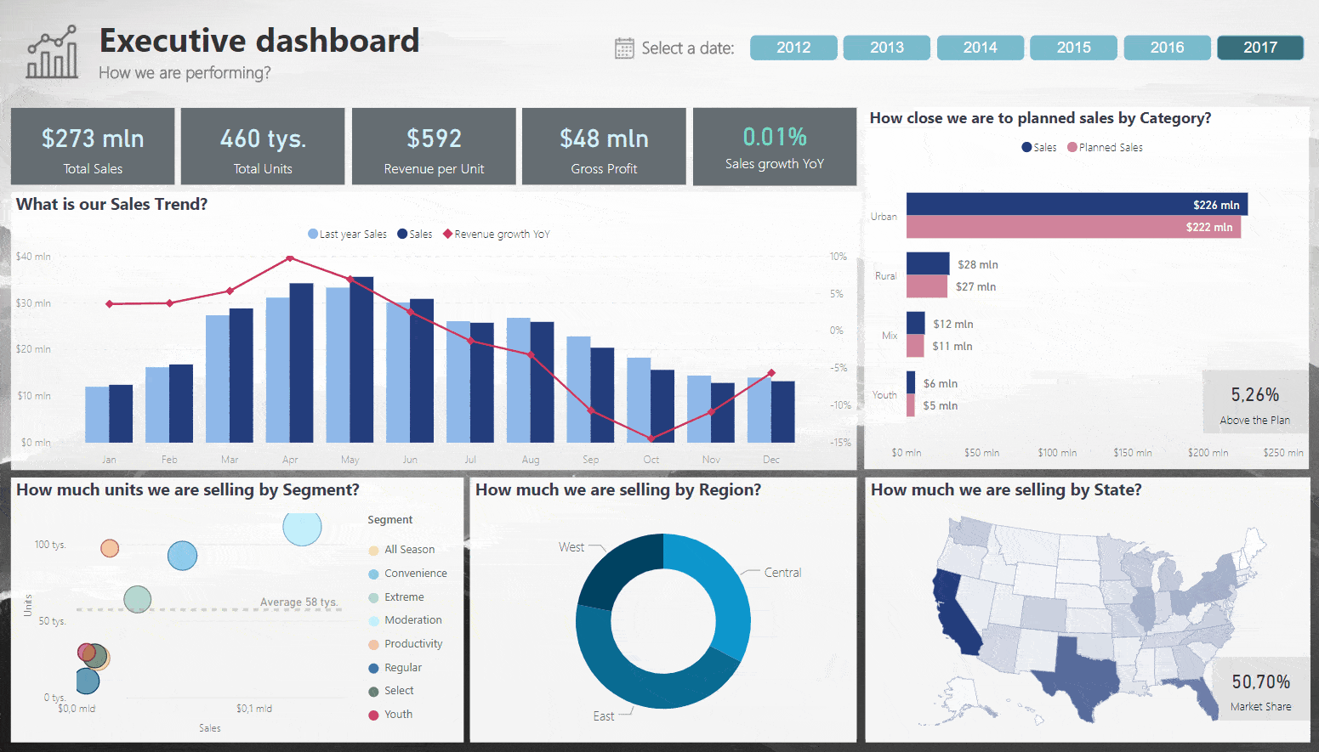
Thank You
Thank you for exploring the world of song analysis by YouTube with Power BI.
For more information or assistance in leveraging data analytics for music insights, feel free to reach out.
Stay tuned for more updates and innovations in the field of music data analysis.
15
Notes:
Image source: https://mungfali.com/explore.php?q=Dashboard%20De%20Power%20Bi

